Slide 1
An Efficient Approach for Dengue Mitigation A Computational Framework
Nirosha Sumanasinghe Dinayadura
UNIVERSITY OF NORTH TEXAS
December 2018
Armin R. Mikler, Major Professor
Chetan Tiwari, Committee Member
Ranee Bryce, Committee Member
Song Fu, Committee Member

Slide 2

Acknowledgement
Major Professor
Armin R. Mikler
Committee Members
Chetan Tiwari
Ranee Bryce
Song Fu

Slide 3
Outline
Problem Statement
Literature Review
Methodology
Results
Conclusion

Slide 4
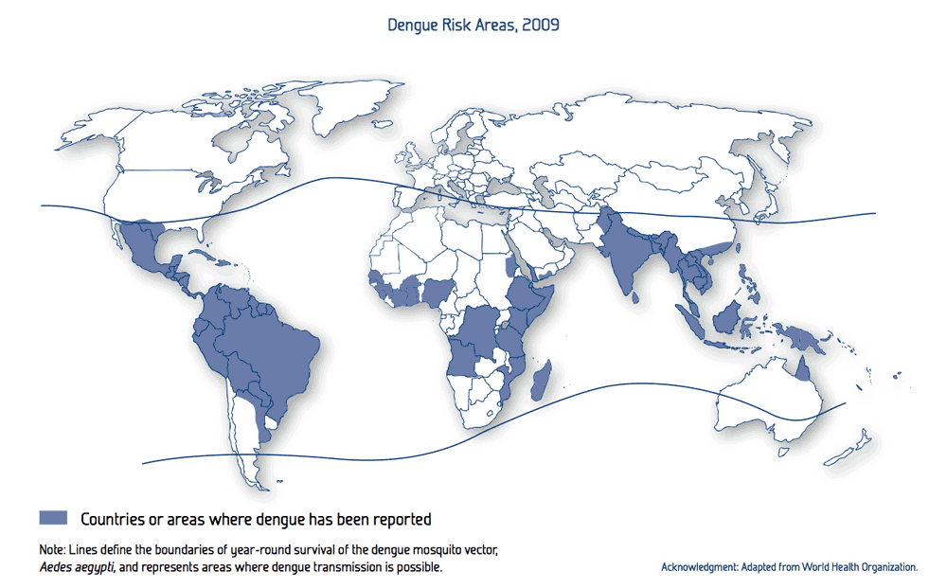
Problem Statement
World Health Organization (WHO) reported that dengue incidence has grown exponentially around the world in last couple of decades
Researchers estimated that 390 million dengue cases per year
Another study conducted estimates that 3900 million people living in 128 countries are at risk
It is prominent in USA neighboring countries

Slide 5
Problem Statement
The status of dengue in south Asian countries is alarming
Sri Lanka reported 37988 dengue cases from Jan to Sept in 2018
In 2017, 158854 cases reported and 300 deceased due to dengue fever

Slide 6
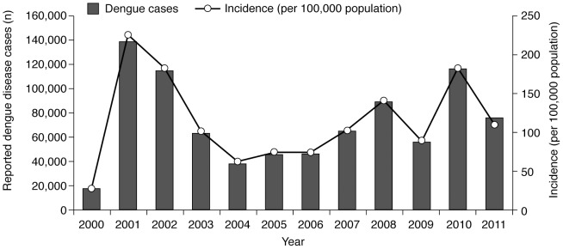
Problem Statement
Thailand reported 6,565 cases from Jan. to April 2018. Nine reported deceased

Slide 7

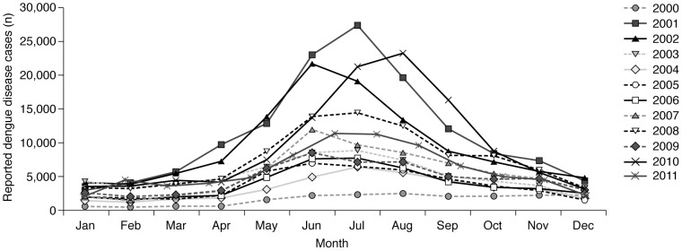
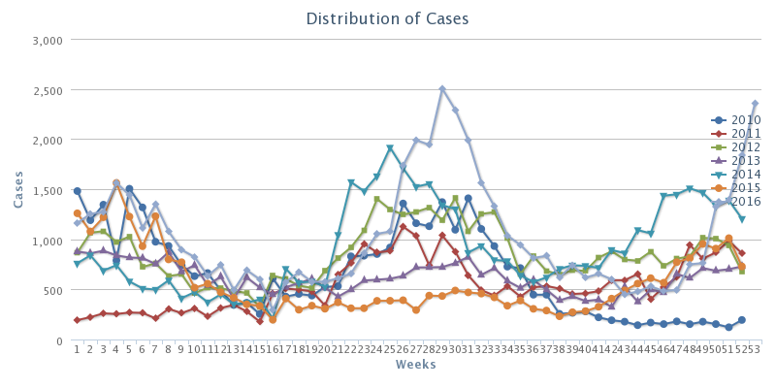
Problem Statement
Dengue is climate dependent
Rainfall is the major contributing factor beside temperature
High population density greatly contributing for quick propagation of the decease

Slide 8
Problem Statement
NEWS Bulletins in Sri Lanka
Dengue mitigation is a big challenge for countries like Sri Lanka and Thailand
Resource scarcity is unavoidable
Proper resource management and allocation is a key factor in successful dengue mitigation

Slide 9
Background
May be about SL and Thai

Slide 10
Literature Review

Slide 11
Methodology
1. Rainfall, Temperature, Dengue Incidence, Population Data
2. Data Alignment and Cropping
Data Acquisition
Data Pre-Analysis
Correlation Analysis
1. Year-wise Data Normalization,
2. Outlier Removal with Iterative Convex Hull Method
Data Pre-Processing
1. SVR
2. Least Square Regression
3. K-NN
4. Ensemble (With Best Models)
Model Generation
1. 10-Fold Cross Validation (Prediction)
2. Proposed Accuracy Calculator
Model Validation
Proposed Genetic Algorithm
Resource Allocation

